Slide 1
Progress Reporting Design and implement the model of smart garden
Increment 1: Planning – Research - Design
Week 3 – Meeting 2

Slide 2
Increment 1 – Sangpt
Schematic

Slide 3
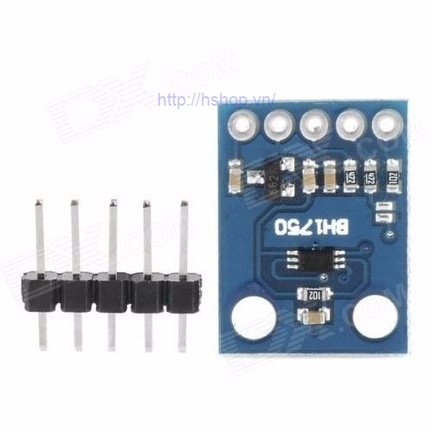
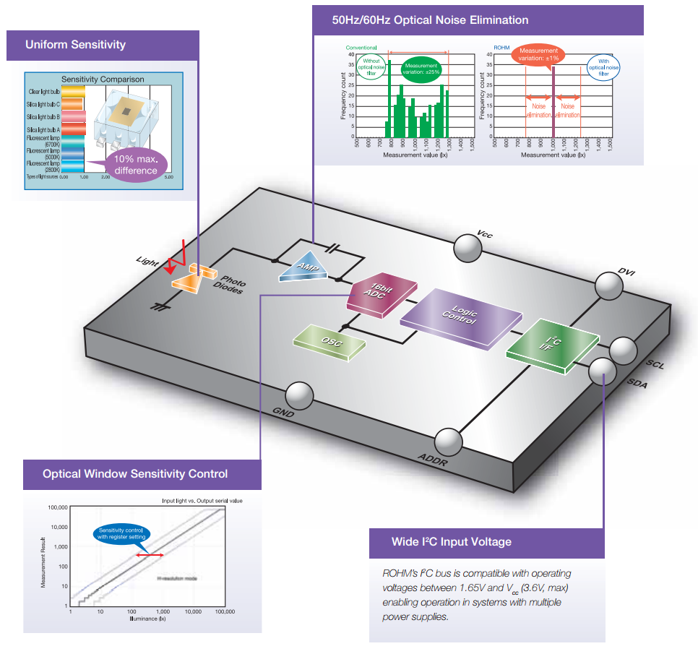
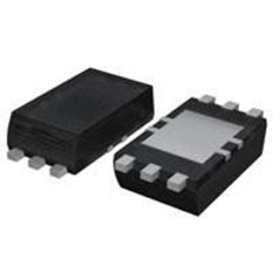
Increment 1 – Chinhph
Light Intensity Sensor - Principles

Slide 4
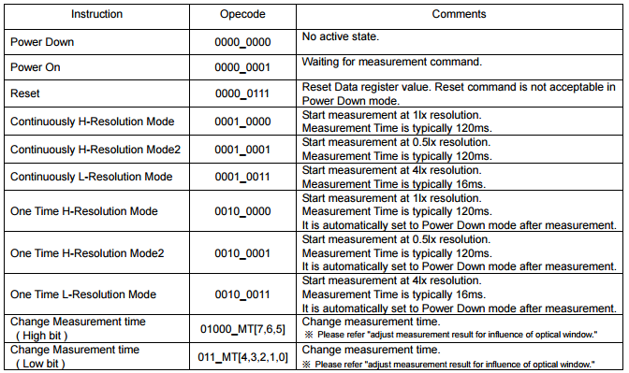
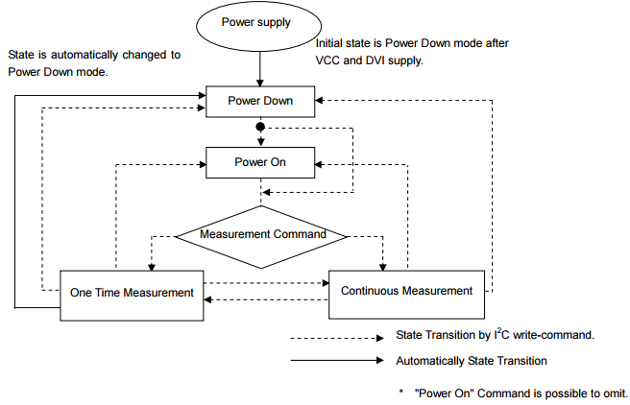
Increment 1 – Chinhph
Light Intensity Sensor - Principles

Slide 5
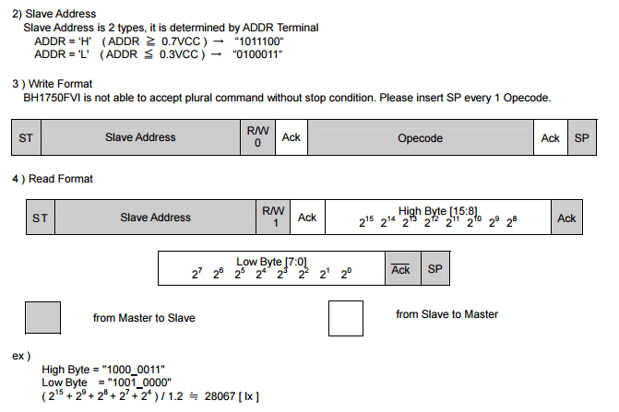
Increment 1 – Chinhph
Light Intensity Sensor - Principles

Slide 6
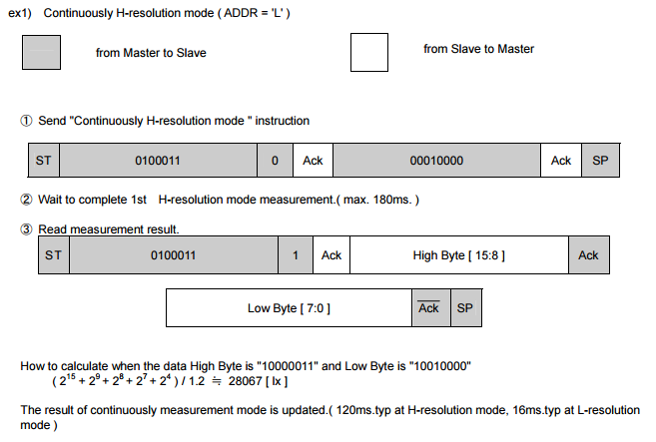
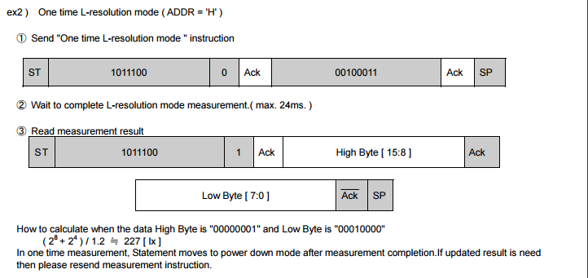
Increment 1 – Chinhph
Light Intensity Sensor - Principles

Slide 7
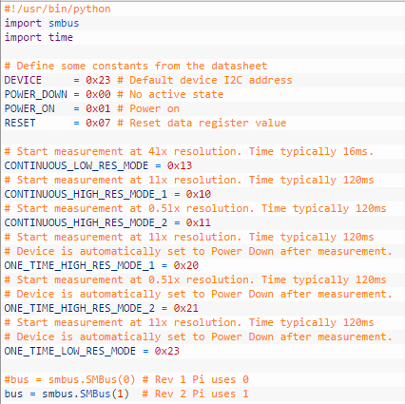
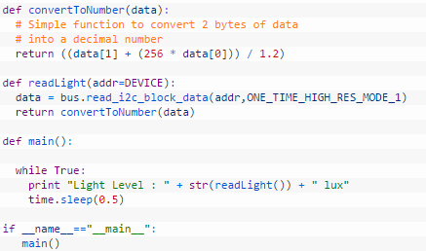
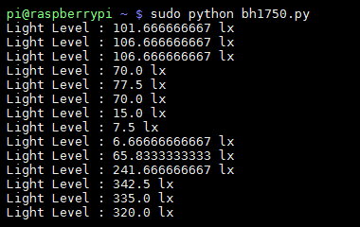
Increment 1 – Chinhph
Light Intensity Sensor – Demo Code on Raspberry using I2C

Slide 8
Increment 1 – Phaplv
Tasks

Slide 9
Increment 1 – Nghihh
Tasks

Slide 10
Increment 1 – Delay & Risks
Hardware: late of order MCU and soil moisture sensor.
Lack of face to face working together.
Lack of member share of understand.

